Slide 1








Lesson 1. Angular Pipes

Slide 2
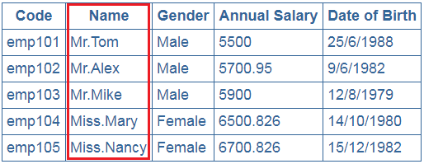
Angular Custom Pipe

Slide 3
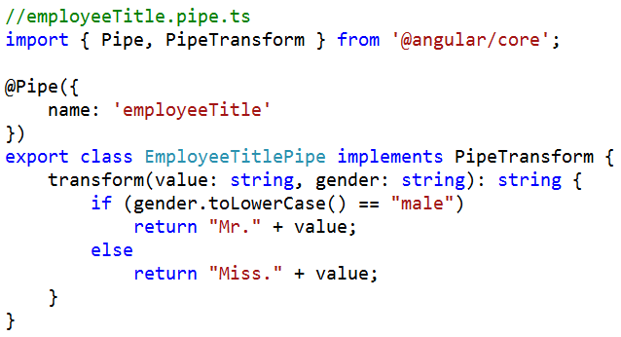
Angular Custom Pipe
Step 1 : Create the custom pipe

Slide 4
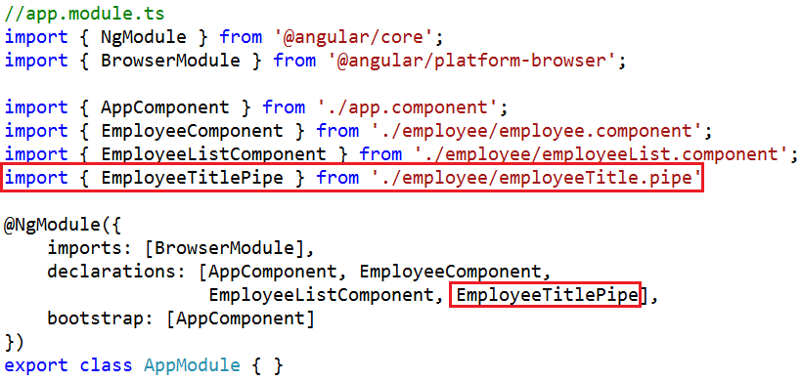
Angular Custom Pipe
Step 2 : Declare the custom pipe in the module where you need it

Slide 5
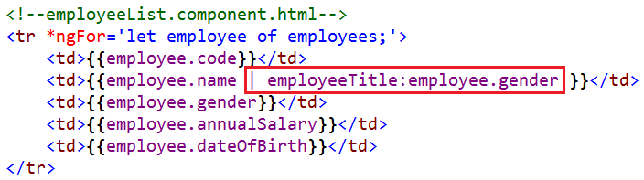
Angular Custom Pipe
Step 3 : Use the custom pipe just like any other built-in angular pipe

Slide 6
Q & A
Contact:rashmipawaskar@synergetics-india.com

Slide 7
Thank You

